Slide 1
Handwritten Nepali Digit Classification
Presented by:
Aashish Pokharel(20786/075)
Milan Chaudhary(20811/075)
Shreedhar Ghimire(20827/075)

Slide 2
Presentation Outline
Introduction
Objectives
System Analysis
System Design
Next Steps

Slide 3
Introduction
Handwritten Nepali Digit Classification is the process to provide the ability to machines to recognize human handwritten digits
It is not an easy task for the machine because handwritten digits are not perfect, vary from person-to-person, and can be made with many different flavors
The project intends to implement a Feedforward Neural Network that will be able to recognize the handwritten digits with high accuracy

Slide 4
Objectives
Following are the objectives of the system:
To identify Nepali digits using Deep Learning Approaches,
To perform tasks such as hyperparameter tuning, normalization, regularization, etc. to create an efficient model,
To integrate the developed model into a given system where user can provide the input and the model gives the predicted outcome.

Slide 5
Scope and Limitation
The project tries to implement a system that will be able to take inputs from user and recognize which nepali digit is given as input.
The System has following limitations:
The system will not be able to recognize Nepali characters other than the digits

Slide 6
System Analysis

Slide 7
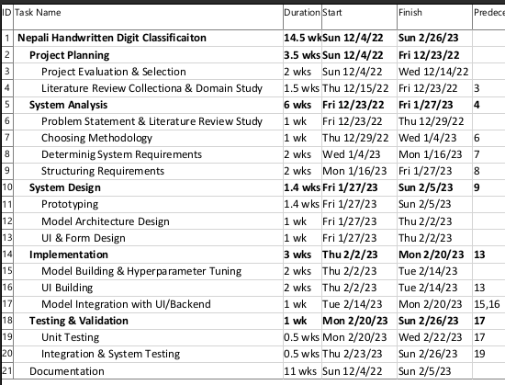
Schedule Analysis : Work Breakdown Structure

Slide 8
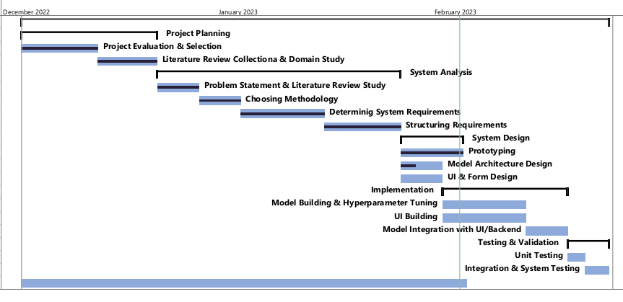
Schedule Analysis : Gantt CHART

Slide 9
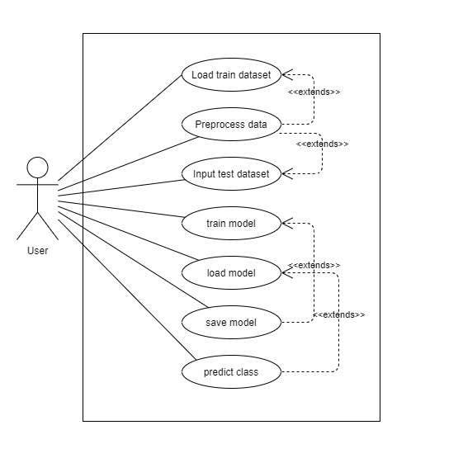
Funtional Requirement :Use case Diagram
The Use case diagram shows the interraction of user with the system.

Slide 10
Funtional Requirement :Use case description
The Use case description contains the description of all the use cases
Ex: Train Model is shown here
Use-Case Identifier | UC4 – Train model
Primary Actor | User
Secondary Actor | None
Description | It trains the model using the training dataset available in the local directory.
Pre-condition | All the required data should be in the local directory or the system should be connected to the internet.

Slide 11
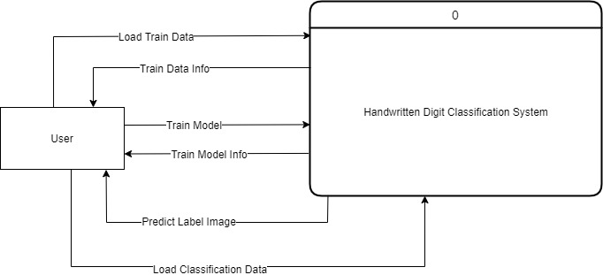
Process modelling : DATA Flow Diagram

Slide 12
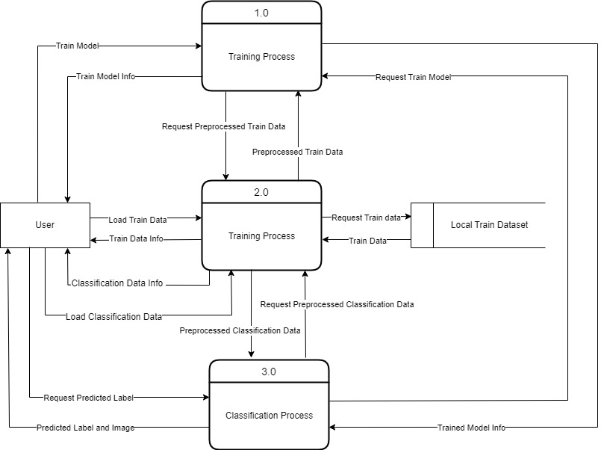
Data Flow Diagram : Level 0

Slide 13
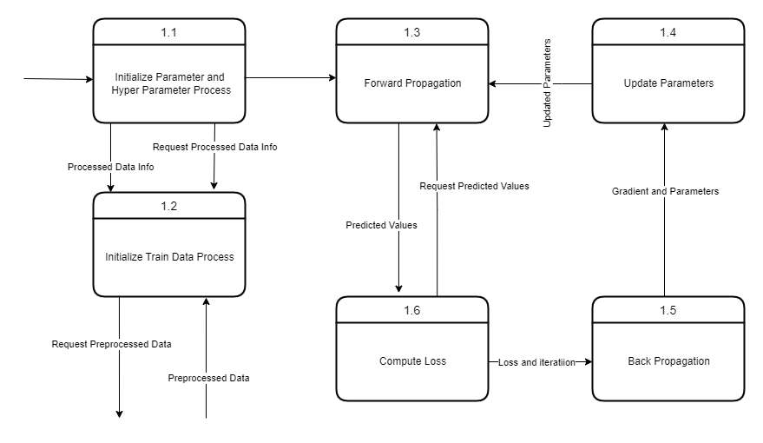
Data Flow Diagram : Level 1

Slide 14
Dataset Analysis
Data for Each label : 2000 (85% train 15% test)
Image format : 32 * 32 pixels
Are all data of same shape ? Yes
Color Channels : 1

Slide 15
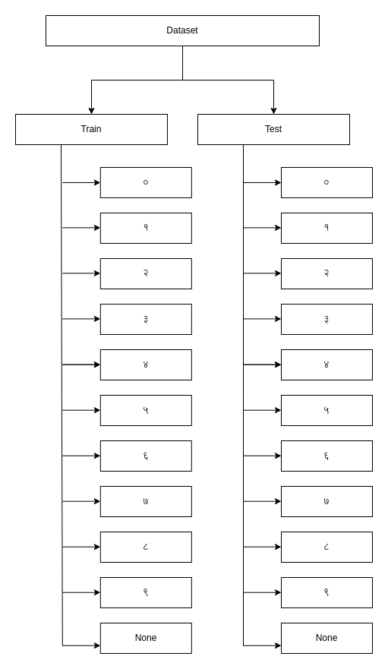
Data orGanization : Folder structure
Dataset divided into:
Train
Test
Data stored in each of their labels

Slide 16
System Design

Slide 17
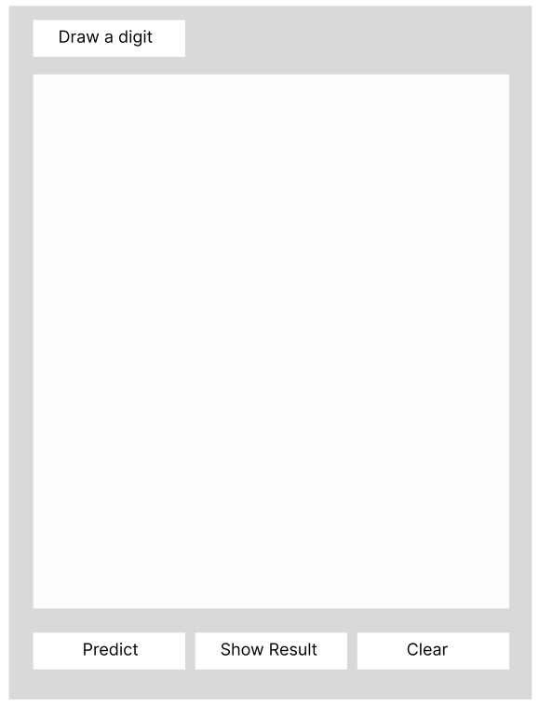
SYSTEM DESIGN : UI WIreframe
The UI will be able to :
Take inputs from user as drawings,
Show the outputs to the user,

Slide 18
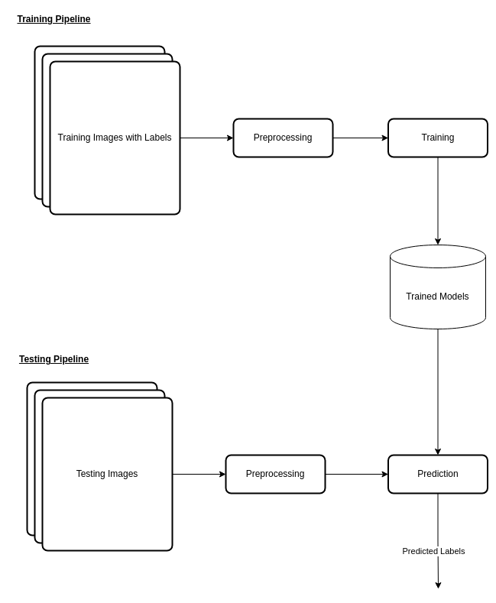
System Design : Model Building Pipeline

Slide 19
System Design : Base Model Architecture
Input layer shape : (1024, 1)
Hidden Layers : 2 Layers, each of size 32
Learning Rate : 0.01
activation function : ReLU

Slide 20
Base Model : Outcomes
Training Accuracy : 90%
Test Accuracy : 87%

Slide 21
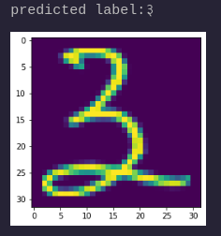
Base Model : Prediction Sample

Slide 22
Next Steps
Use of Object Oriented Approach to build the model
Model optimization and fine tuning
UI and backend implementation
Finalize the documentation

Slide 23
Th
THANK YOU !!!

